Slide 1
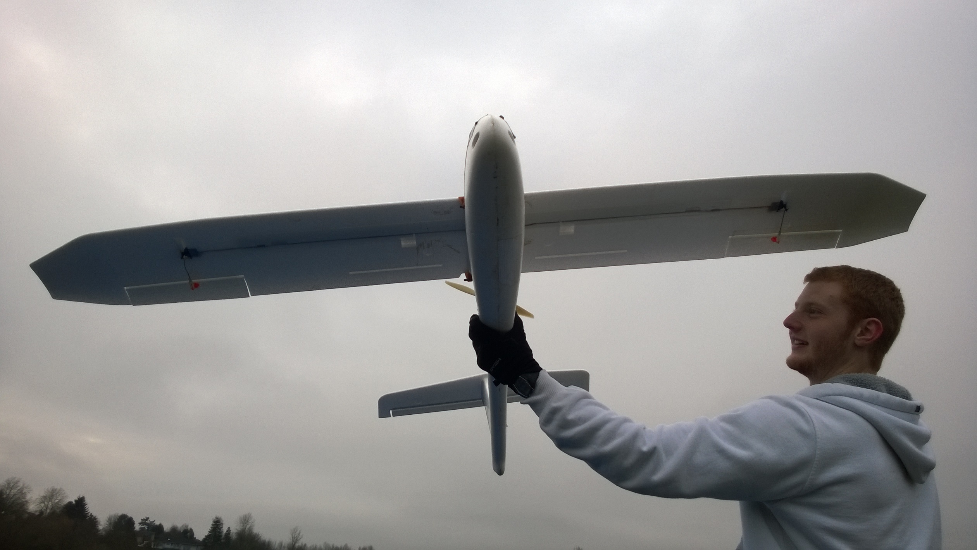
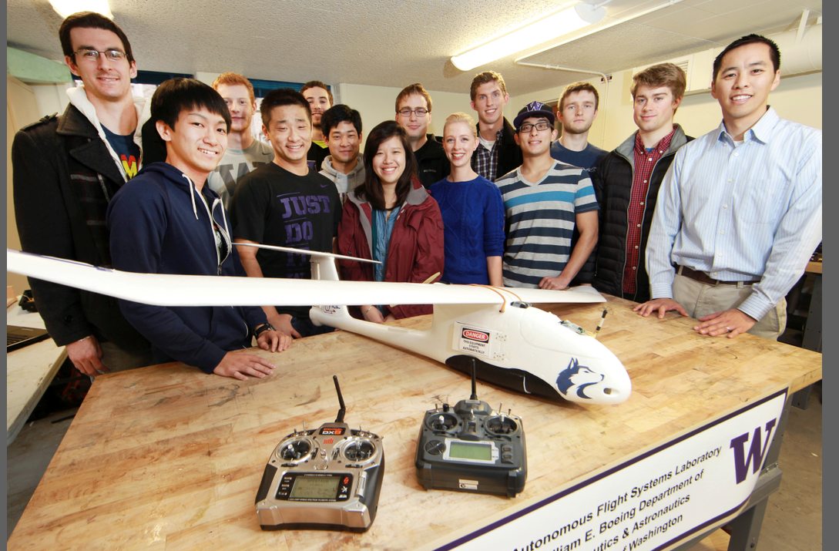
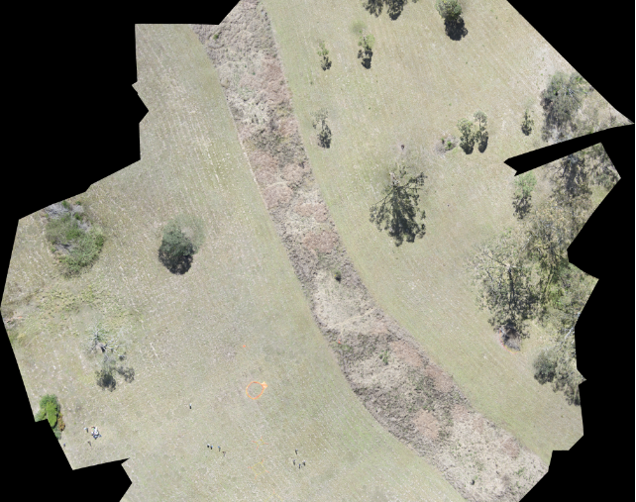
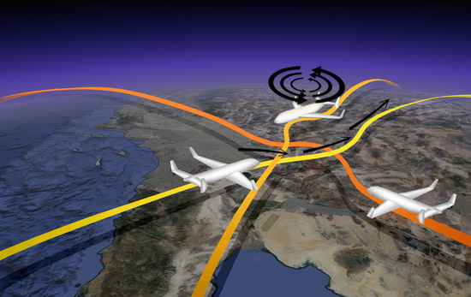
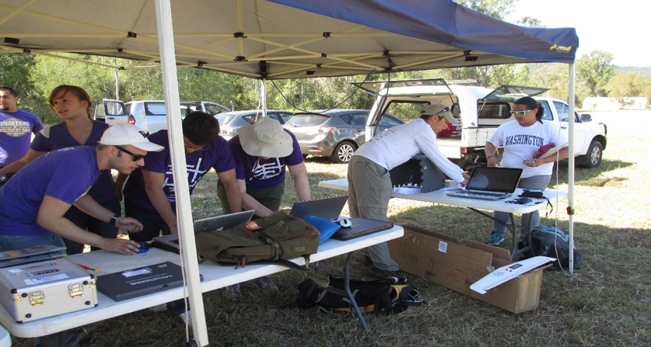
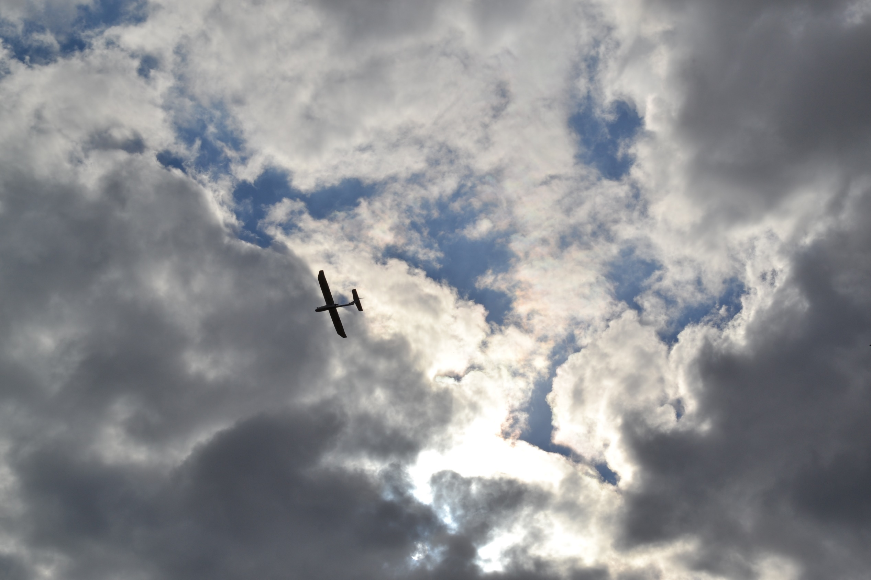
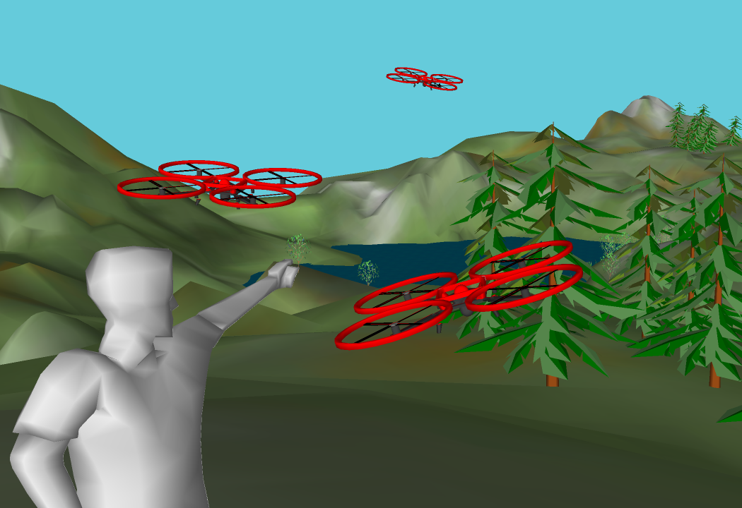
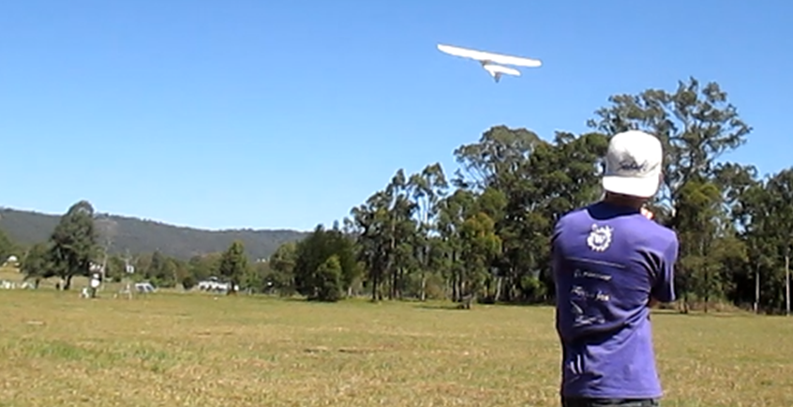


William E. Boeing Department of Aeronautics & Astronautics
Unmanned Aerial Systems
The next aerospace revolution
HEADLINE
The Unmanned Aerial Systems (UAS) industry is one of the fastest-growing industries in the United States. Traditionally, UAS have been a military tool used primarily for performing intelligence, surveillance, and reconnaissance missions. However, with the Federal Aviation Administration (FAA) actively integrating these systems into the National Airspace System (NAS), civilian and commercial usage of UAS is expected to increase dramatically in the next several years.
Small and medium sized UAS will likely experience the greatest near-term growth in civil and commercial operations.
Washington State stands to gain nearly 10,000 jobs and $7.8 billion as this market expands over the next decade.
Now is the time to become involved as commercial usage of UAS have only recently become authorized by the FAA.
research at the university of Washington
The University of Washington (UW) is the premiere research institution in the Pacific Northwest with active research programs and expertise in UAS. The Autonomous Flight Systems Laboratory (AFSL) at the University of Washington conducts UAS related research in areas such as:
UAS for precision agriculture and farming.
Topographical, ecological, & biological monitoring w/ UAS.
UAS operator/pilot training and interface design.
UAS flight control and avionics verification and validation.
Operation of UAS in GPS-denied environments.
Wildfire monitoring and detection using UAS.
Control of networked UAS systems.
Collision awareness, avoidance, and airspace management.
Search and target identification
Path planning with realistic weather models
Geomagnetic surveying

Slide 2
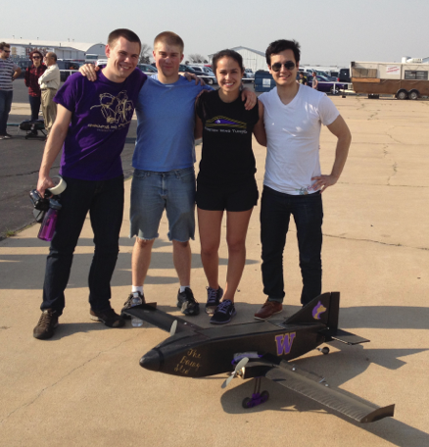
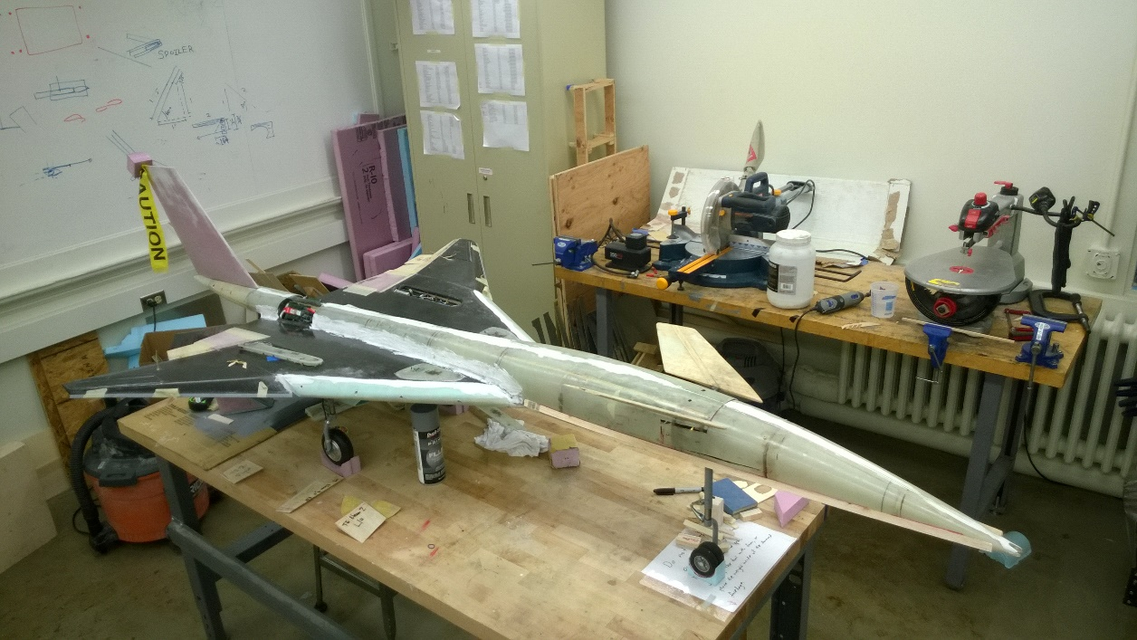
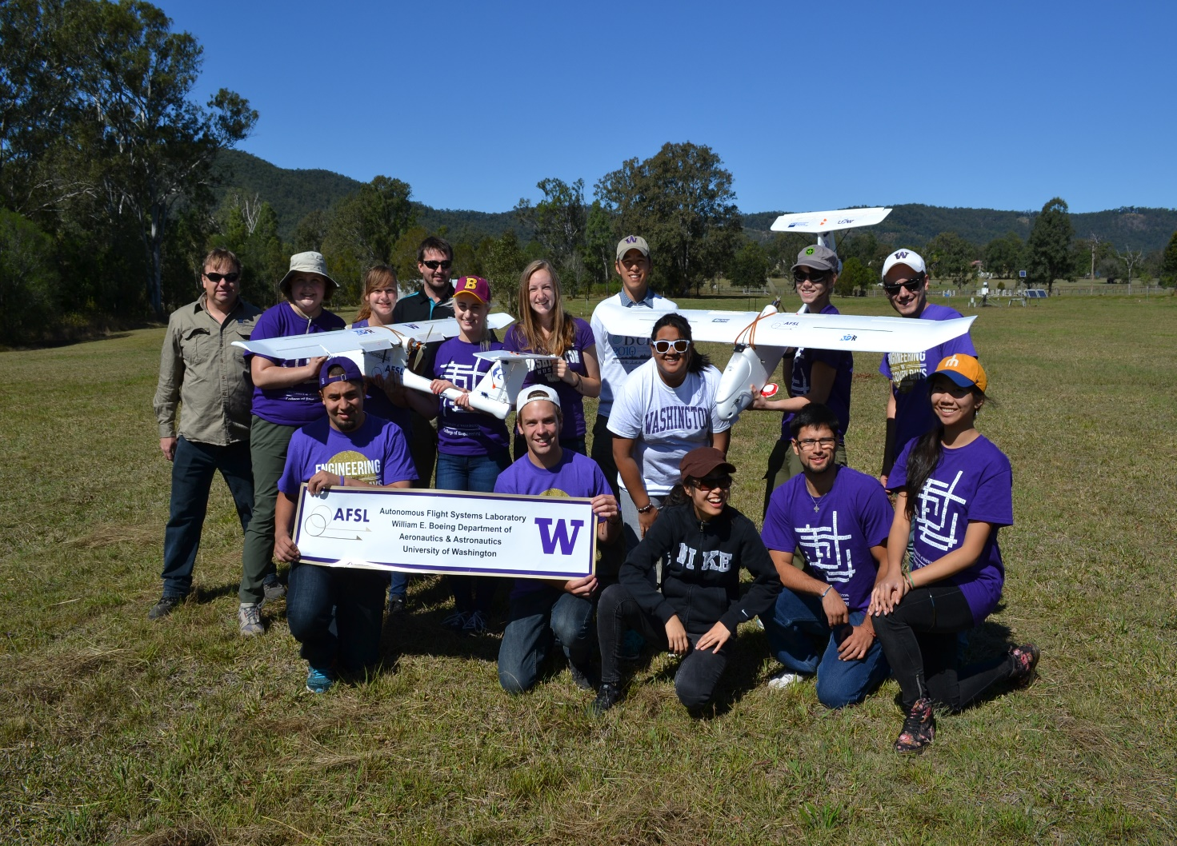
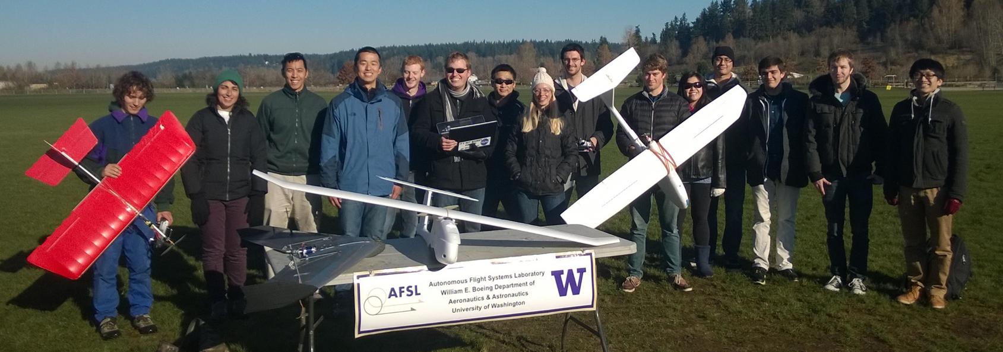
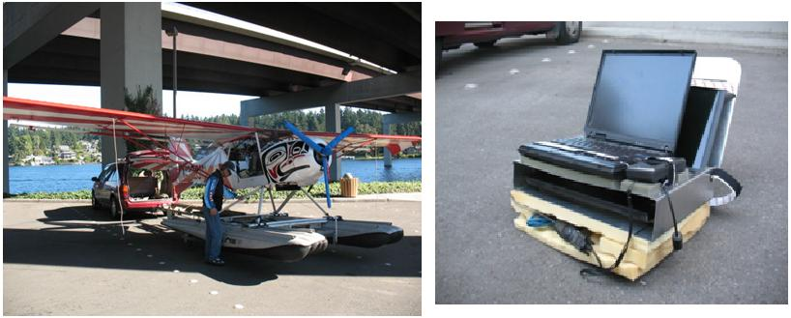
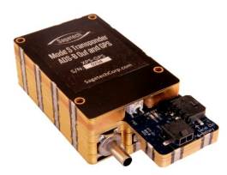
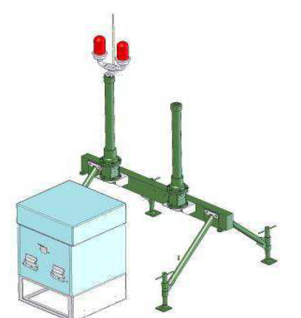
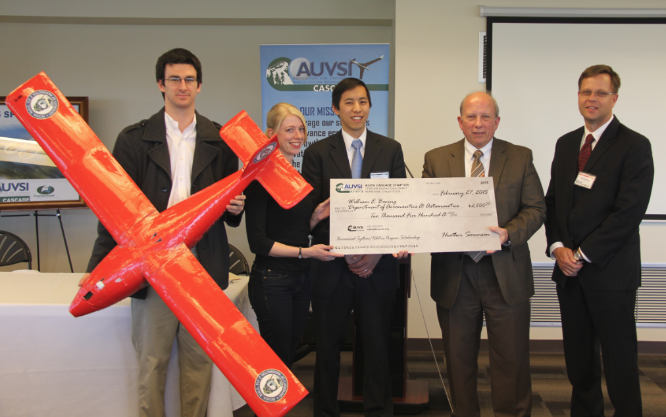

William E. Boeing Department of Aeronautics & Astronautics
Vast educational potential
Design, Build, Fly
Each year UW students participate in the AIAA Design/Build/Fly competition. Student teams design, fabricate, and demonstrate the flight capabilities of an unmanned, electric powered, radio controlled UAS that can best meet the specified mission profile.
UAS provide an excellent platform for student education within Washington State. The UW has several educational programs, courses, and activities that involve UAS related technologies.
Senior Aircraft Design
Senior undergraduate students with an interest in aeronautical engineering can participate in a rigorous, 6 month course focusing on design, analysis, manufacture, and flight testing of a custom aircraft.
2014, students at the competition in Wichita, KS
Dawgs Fly
Dawgs Fly is a registered student organizations at the UW that focuses on radio controlled (RC) flight. It attracts aviation enthusiasts and hobbyists from many departments on campus. Students are exposed to the world RC aircraft with a focus on UAS systems and technologies.
UAS Study Abroad Australia
Each summer, the UW conducts a study abroad class in Brisbane, Australia at the Queensland University of Technology (QUT). This class focuses on UAS and collaboration with other robotic systems. Students learn about UAS and their impact on the global economy and society. Students conduct flight tests to gather environmental data such as multi-spectral imagery and telemetry.
2015, students and Dr. Matthew Dunbabin at the Samford Ecological Research Facility (SERF) in Camp Mountain, QLD, Australia
Localization and Situational Awareness in GPS-Denied Environments
The UW is developing a system to allow UAS to operate in GPS-denied environments. This system uses a combination of ADS-B transponders and multilateration systems to provide situational awareness to a UAS operator even if the aircraft is unware of its GPS location. This project includes flight test demonstrations of UAS interacting with manned aircraft in the National Airspace System.
Thank You AUVSI Cascade
The UW greatly appreciates the support of the AUVSI Cascade chapter. Funds provided by AUVSI Cascade were used to support student UAS projects in areas such as precision agriculture, vision based navigation, and unmanned systems design.

Slide 3
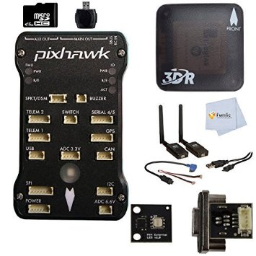

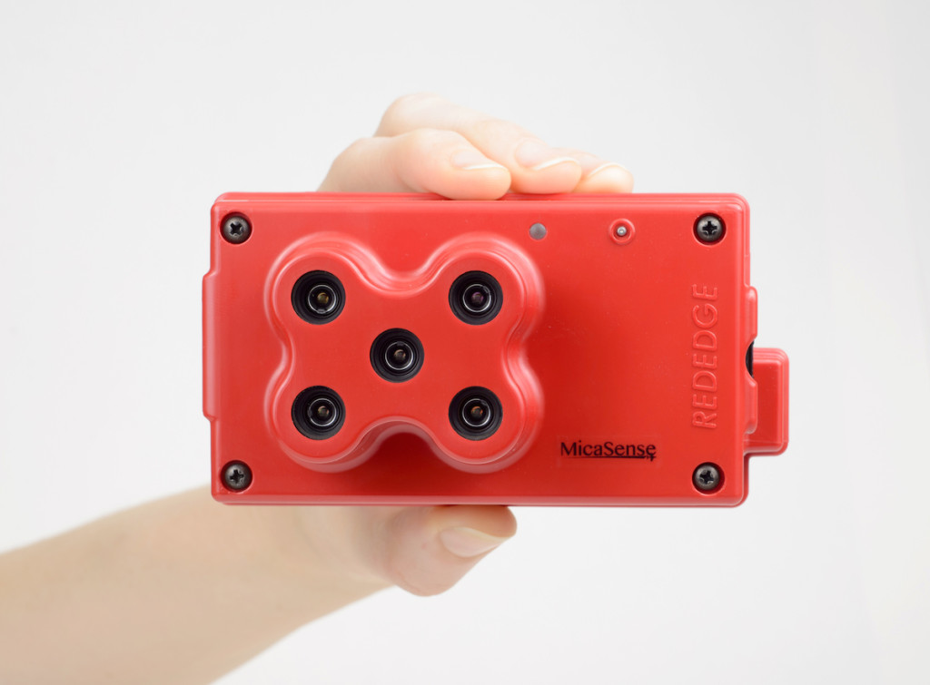
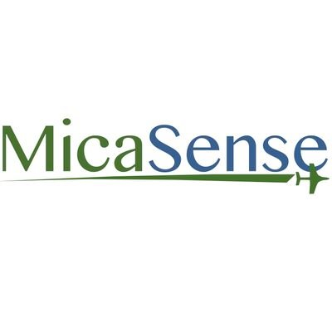
Thank You 3DRobotics
The UW AFSL extensively utilizes avionics and equipment from 3DRobotics. Aircraft are equipped with Pixhawk autopilot systems that communicate with a ground station via the 3DR radio set. Combining this with the 3DR uBlox GPS, Pixhawk Airspeed Sensor Kit, and the Pixhawk External LED and USB port makes AFSL aircraft truly autonomous and able to support advanced aerospace research at the UW. Thank you 3DRobotics!
Thank You Micasense
The UW AFSL extensively utilizes the MicaSense RedEdge camera and associated technologies such as the Atlas data processing and analysis service. MicaSense technologies such as these transform UW aircraft into advanced remote sensing platforms capable of advanced agricultural research. MicaSense has continued to support advanced aerospace research and education at the UW. Thank you MicaSense!

Slide 4





Are you interested in UAS at UW? Please contact:
Christopher Lum, lum@u.washington.edu
https://www.aa.washington.edu/research/afsl/research

